Slide 1
Working progress
Tim Klebig

Slide 2
Tests
24 pure water 35°C
34 35°C/40 recharged
40 recharge 35°C HATCOL (← closed ceiling and lower air velocity)
28 new comp 55°C
38 recharge 55°C HATCOL (← closed ceiling and lower air velocity)
45 2nd recharge 55°C

Slide 3
35°C Cond.-Temp.
10 pct
 | 24 pure water 35°C | 34 35°C/40 recharged | 40 recharge 35°C HATCOL
Q_75 | 6.68 | 5.48 | 5.82
Q_10 | 6.21 | 5.26 | 5.77
Q_cond_75 | 9.08 | 7.92 | 8.19
COP_75 | 2.49 | 2.04 | 2.29
X_cond_C1 | 1% | 27% | 32%
X_cond_C2 | 0% | 18% | 28%
X_cond_C3 | 12% | 19% | 34%
T_min | 1.6 | 2.07 | 4.3
T_max | 10.5 | 10.8 | 13
T_air_in | 8.95 | 8.42 | 10.17
T_air_out | 0.3 | 1.07 | 3.62

Slide 4
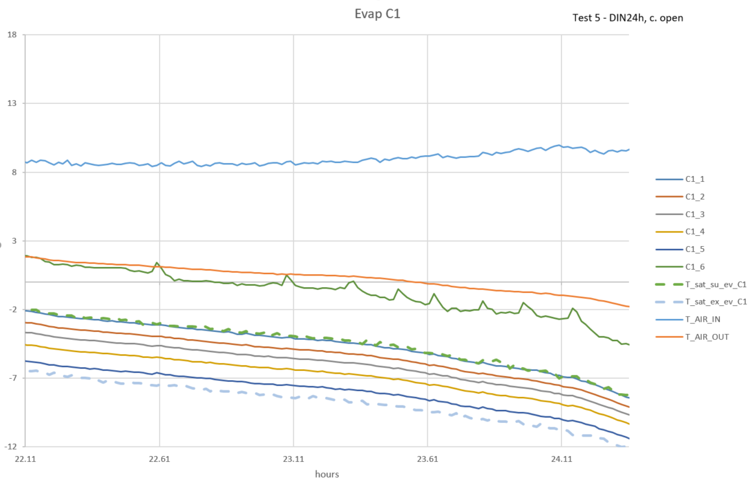
TEST 24
3h defrost
24.36

Slide 5
TEST 24
3h defrost
24.06
24.36

Slide 6
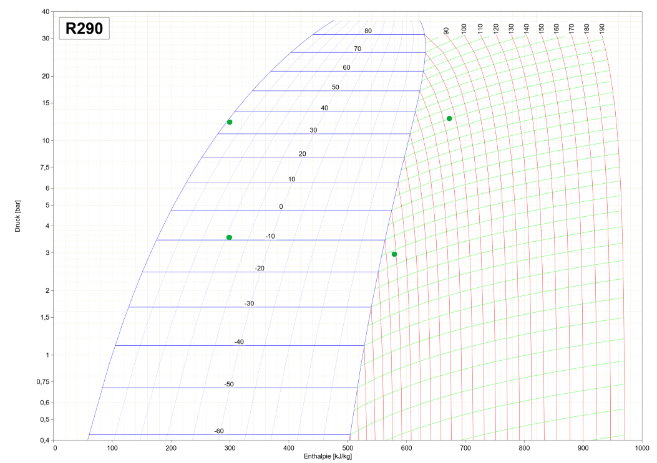

Slide 7
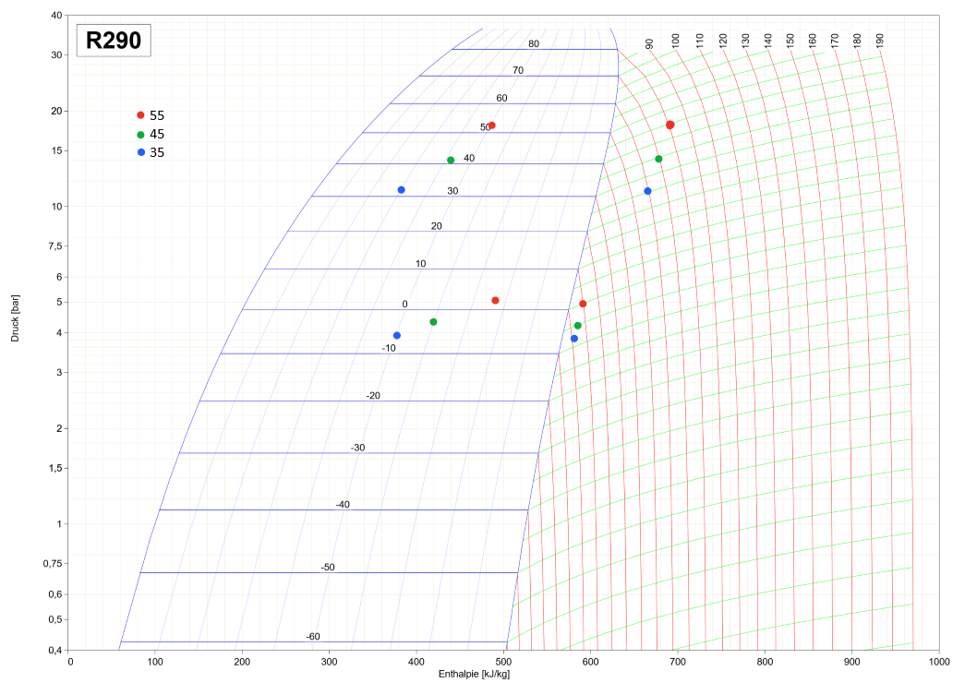

Slide 8
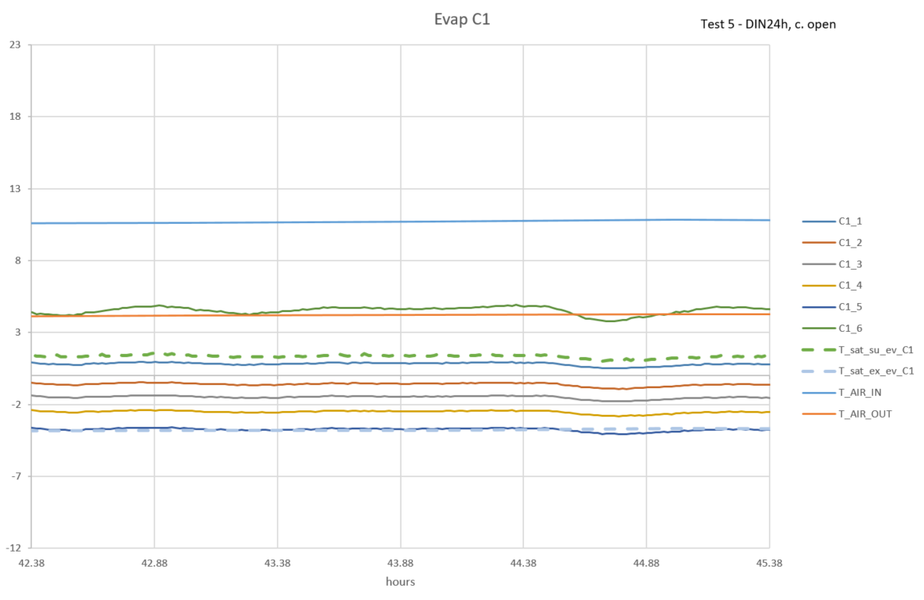
TEST 40
4h defrost

Slide 9
55°C Cond.-Temp.
10 pct
 | 28 new compr | 38 recharge HATCOL 10% | 45 2nd recharge 30%
Q_75 | 4.46 | 3.9 | 4.31
Q_10 | 4.49 | 3.79 | 4.29
Q_cond_75 | 7.77 | 7.31 | 7.69
COP_75 | 1.23 | 1.06 | 1.17
X_cond_C1 | 33% | 50% | 36%
X_cond_C2 | 40% | 46% | 38%
X_cond_C3 | 22% | 46% | 33%
T_min | 5.3 | 9 | 5.8
T_max | 12.2 | 15.8 | 13.7
T_air_in | 9.83 | 14.02 | 10.65
T_air_out | 4.22 | 8.68 | 5.12

Slide 10
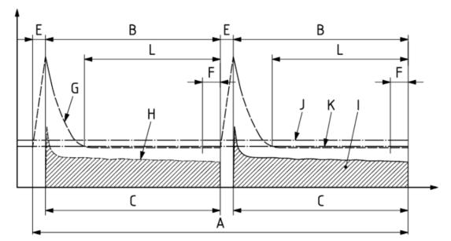
Data Processing
A : only the last period instead of 24h
B = C : t_{run} & t_{refr}
E : t_{deft} – defrost off period
F : t_{run}*10% - running time for reporting minimum evaporating temperature
G : evaporating temperature
H / I : instant/total heat extraction rate
L : t_{run}*75% -> Average

Slide 11
Python Output
Last period
Cooling capacity
TEC
Average over 75% of the last period
COP
Product temperature
LMTD condensor
Average over 10% of the last period
Values for log ph diagram

Slide 12
Compressor weights
 | 1 | 2 | 3
Standard (to Wlk) | 21.978 | 22.004 | 21.986
Hybrid (arrival) | 22.183 | 22.150 | 22.146
19.10. (to Wlk) | 22.135 | 22.095 | 22.085
20.10. (return) | 22.262 | 22.200 | 22.244

Slide 13
Next steps
Flush the system
Work on the model
Evolve Python Script /w Kristian
Drawing off the air distribution in the chamber with different settings
Graphic of compressor weight

